Slide 1
CARBON DIOXIDE
EMISSION ANALYSIS
G1T4: Sharifah, Kheng He, Stella, Wasim, Luqman
Introduction
Related Works
Dataset
Demo & Results
Future Work
Notes:
Good Afternoon Everyone! I’m Sharifah and this are my teammates Kheng He, Stella, Wasim and Luqman.
Together we make Team 4 and we’ll be presenting our research surrounding Carbon Dioxide Emissions today!

Slide 2
01
Introduction
Introduction
Related Works
Dataset
Demo & Results
Future Work
Notes:
First and foremost, our team decided to settle on the topic of Carbon Emissions mainly because there has been alot of recent spotlight and developments on climate change and also governmental interventions.

Slide 3
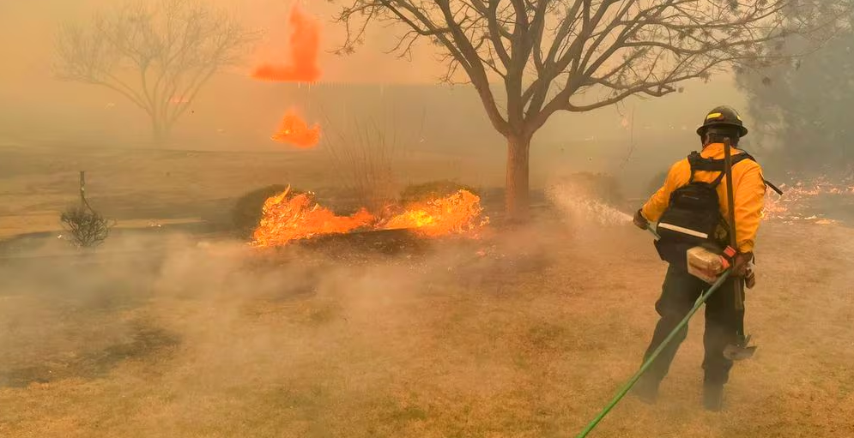
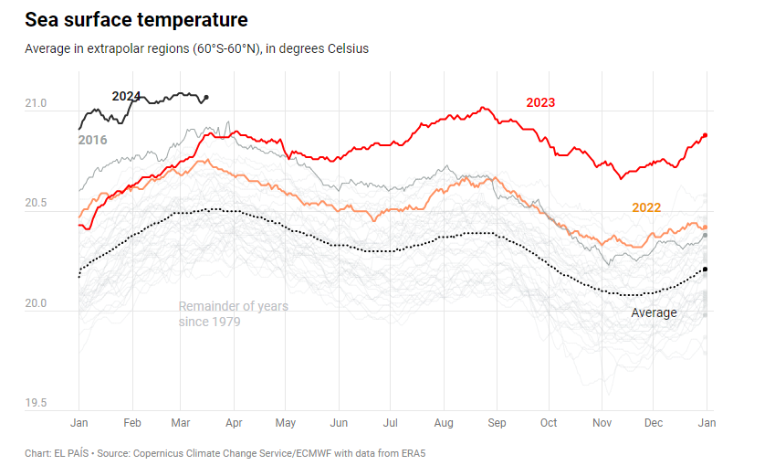




> 90%
> 50%
72%
2023
Earth’s climate warming contributed by greenhouse gases (GHG)
GHG level 50% above pre-industrial level right now
72% of greenhouse gases contributed by carbon dioxide (CO2)
Global temperature reached the highest level in 2023
Introduction
Related Works
Dataset
Demo & Results
Future Work
Notes:
As of 2023, Greenhouse Gas levels are 50% above the pre-industrial level and around 72% of greenhouse gas emissions are contributed by carbon dioxide.
Global temperatures have also reached a record high.

Slide 4
Problem
2015
195
limit increase to 1.5 C
The 1.5 C climate benchmark
As more regions around the world face extreme weather,, countries around the world signed the Paris Agreement in 2015, a landmark international treaty where nations pledged to hold the Earth’s temperature by limiting the temperature increase to 1.5 degrees Celsius above pre-industrial levels.
Year
Countries
to avoid irreversible climate effects that would occur beyond a 2 degrees Celsius increase
Introduction
Motivation
Related Works
Dataset
Demo & Results
Future Work
Notes:
So in order to curb the increasing carbon emissions, countries have pledged to target the 1.5 degree climate benchmark in the 2015 Paris Agreement, where they aim to limit the global temperature increase to 1.5 degrees celsius, to avoid irreversible climate effects that would occur beyond a 2 degree celsius increase.

Slide 5



Problem Statement
Identify the primary drivers behind carbon dioxide emissions and pinpoint focus areas to mitigate the rate of global warming
Limit increase to 1.5 degrees Celsius benchmark set internationally by IPCC
Identify the primary drivers behind carbon dioxide emissions to mitigate the rate of global warming
Prevent Irreversible effects happening to the Earth
Introduction
Motivation
Related Works
Dataset
Demo & Results
Future Work
Notes:
With this benchmark in mind, our project thus aims to identify the primary drivers behind CO2 Emissions and to gain a clearer understanding of what goes on behind the scenes of the emission numbers -For example, Why are some countries seemingly emitting more CO2?, or whether there are certain contributing factors that play a bigger role in a country’s CO2 emissions?

Slide 6
02
Related Works
Introduction
Related Works
Dataset
Demo & Results
Future Work
Notes:
So This was definitely something we looked into whilst doing our pre-search.

Slide 7
Related Research Paper
Work Name | Year | Author | Interesting Insights
Renewable energy, carbon emissions, and economic growth in 24 Asian countries: evidence from panel cointegration analysis. | 2017 | Lu W. C. | Positive correlation between energy consumption and CO2 emission in 6 countries (Philippines, Pakistan, China, Iraq, Yemen, and Saudi Arabia), while the rest had a mix of insignificant negative and positive effects
Economic growth, CO2 emissions and energy consumption: What causes what and where? | 2018 | Acheampong, A. O. | Positive correlation between global economic growth and CO2 emission Positive correlation between energy consumption and CO2 emission in MENA and negative correlation in Sub-Saharan Africa and Caribbean-Latin America.
Causal relationship between trade openness, economic growth and energy consumption: A panel data analysis of Asian countries | 2014 | Nasreen, S., & Anwar, S. | Impact of economic growth on energy consumption is positive
Dataset
Dataset
Demo & Results
Demo & Results
Future Work
Introduction
Future Work
Introduction
Related Works
Related Works
Notes:
We mainly looked into 3 research papers where we found
Positive correlation between energy consumption and CO2 emissions in 6 countries
A positive correlation between global economic growth and CO2 emission

Slide 8
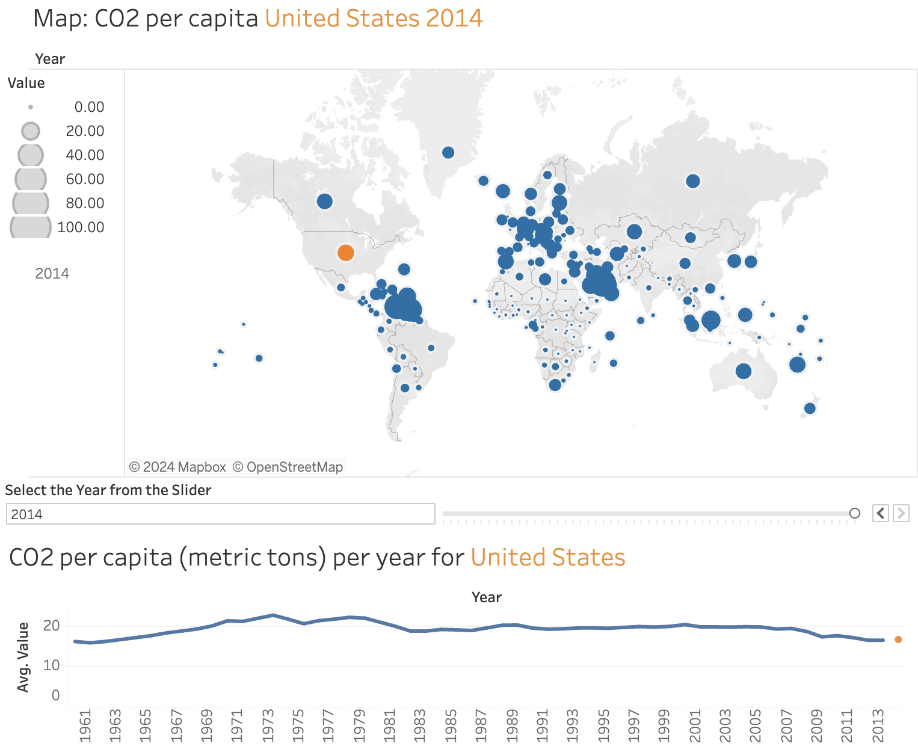
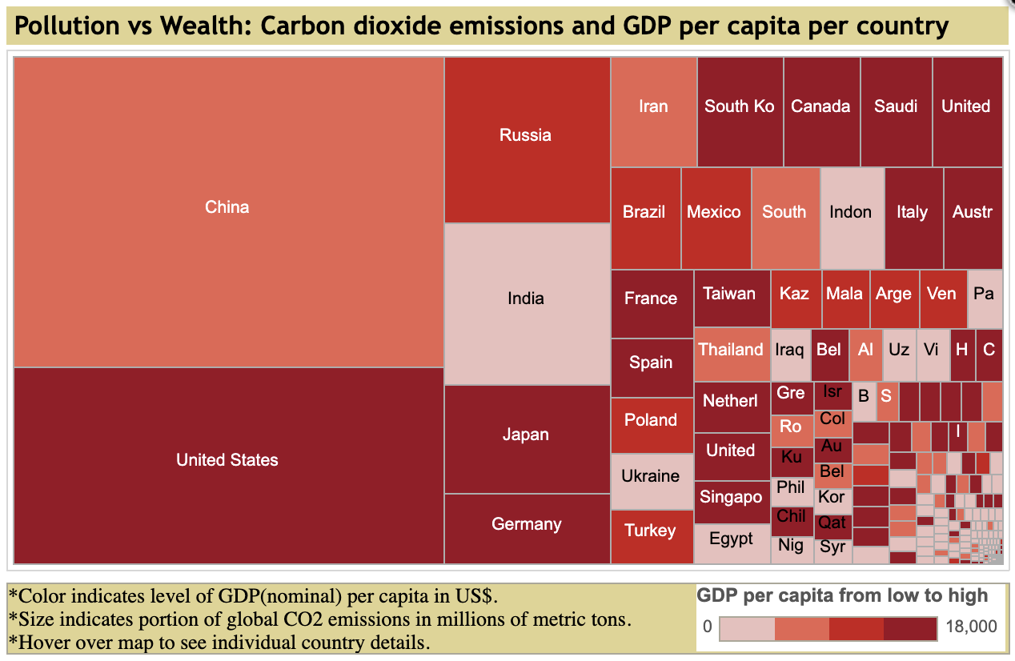
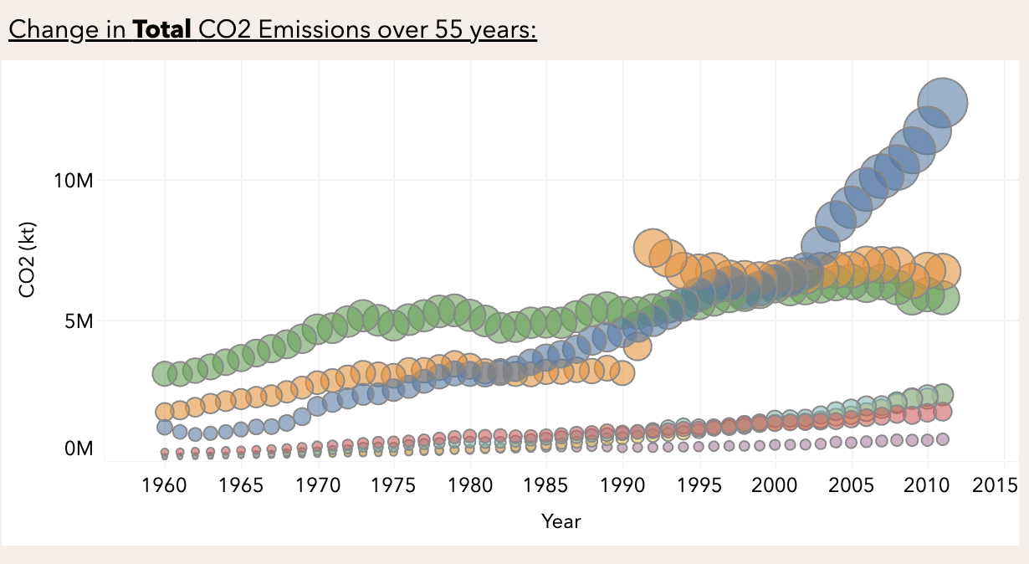
What we found
Areas for Improvement
Most of the tableau analyses the changes of CO2 emission throughout the years
Some further explore on whether wealthier countries are emitting more CO2
Lack of depth, not really showing what’s contributing to CO2 emission
Analyses the relationship between CO2 emission and 4 other variables (Volume of trade, trade-to-GDP ratio, Energy Consumption, GDP)
Introduction
Related Works
Dataset
Demo & Results
Future Work
Notes:
And overall,
Looking into visualizations related to our research topic, we’ve found that most tableau analyses are very surface level, with many visualising emissions of wealthier countries and making very general assumptions. They didn’t really show what’s contributing to CO2 emissions and missed out on many possible relevant variables such as volume of trade, Energy Consumption etc. So for our team, we did ensure to include them in our analysis so that we’re able to gain more beneficial insights ,given that prior research mentioned earlier have shown important findings wrt to these variables.
I’ll now pass the time to Luqman to talk about the datasets.

Slide 9
03
Dataset
Introduction
Related Works
Dataset
Demo & Results
Future Work
Notes:
Thanks Sharifah, I will now be talking about the datasets used for our analysis

Slide 10


Datasets Used
No. | Dataset | Relevant Columns | Source
1 | CO2 Emission by countries Year wise (1750-2022) | Countries, Year, CO2 Emission, Area, Population (2022) etc.
2 | World Per Capita Electricity Consumption | Countries, Per Capita Electricity Consumption
3 | GDP (current US$) | Countries, GDP (USD Million)
4 | Population, total | Countries, Population (Thousands)
5 | Imports of goods and services (% of GDP) | Countries, Import Trade % of GDP
6 | Exports of goods and services (current US$) | Countries, Export Trade of GDP (USD Million)
Introduction
Related Works
Dataset
Demo & Results
Future Work
Notes:
A total of 6 Datasets obtained from Kaggle and The World Bank were used to form a consolidated final dataset. The first dataset contains the main information regarding the CO2 Emissions of over 200 countries for the years 1750 to 2020.
However, to validate our related works findings, certain information were not available on the main dataset, and the group further sourced for additional data that could provide economic performance indicators information such as GDP, Import and Exports information and electricity consumption information.

Slide 11




Tools utilised
Python and Matplotlib
(Data Cleaning)
Tableau
(Visualisation purpose)
D3.js
(Supplementary Visualisation)
Introduction
Related Works
Dataset
Demo & Results
Future Work
Notes:
With the 6 Datasets, we will conduct data cleaning and utilise Python and the Matplotlib library to explore and prepare the data across the various datasets
Tableau, will be then be used to contain the main data visualization and to build a dashboard
Lastly, we utilise D3.js in the exploration of certain individual visualization worksheets

Slide 12


Dataset Cleaning Process
Data Exploration
Data Merging
Finalised Dataset
Introduction
Related Works
Dataset
Demo & Results
Future Work
Notes:
The Dataset Cleaning Process will be done in Python and it consists of the following
Data Exploration to assess the data quality
Data Merging to determine the compatibility of datasets to be merge
Compiled a Finalised Dataset that contains all required information into a single excel sheet

Slide 13
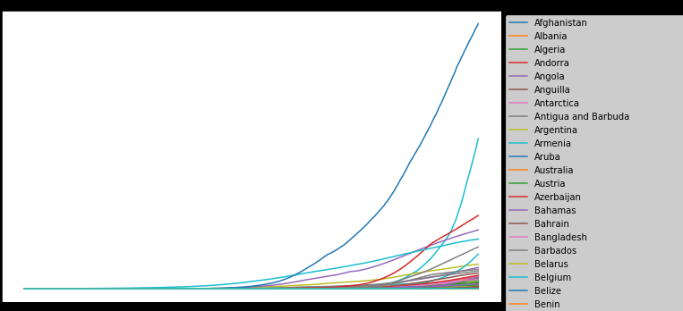
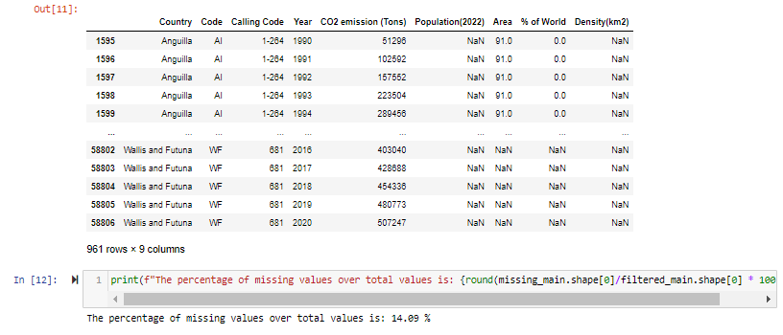
Data Exploration
Purpose: Explored raw data with Python to determine data quality.
Findings
Significant number of 0 CO2 Emission values
Countries with missing important information
Actions Taken
Limit year coverage: 1990 - 2020
Limit number of countries: 189
Introduction
Related Works
Dataset
Demo & Results
Future Work
Notes:
For Data Exploration, the initial raw data will be explored to gain a better understanding of the values available.
We found out that the early years of the dataset contains mostly 0 c02 emission value which might not be very significant in our findings. Out of the countries available, some of them have significant missing values, which makes some countries hard to be compared to others.
As a result, we have filtered the data to contain a period of time from 1990 - 2020, and the number of countries to 189 so that we able to focus on countries and period of years with meaningful available data. This will be the baseline required information for our analysis, moving forward.

Slide 14



Data Merging
Populate supplementary information from additional datasets into the main dataset
Align the countries across various datasets
Merge the datasets based on unique column ‘Country’
Map a continent to each Country
Introduction
Related Works
Dataset
Demo & Results
Future Work
Notes:
Secondly, data merging is then done, to consolidate all the 6 datasets information into one.
Each additional dataset will then be explored to determine the range of information available against with the baseline information prepared, to ensure that we are able to obtain required information for the filtered countries and period of years with the least number of missing values possible.
As we would like to conduct cross continent analysis as well, we have also manually map a continent to each unique country.

Slide 15


Final Dataset
Gross Domestic
Product
CO2 Emission
6 Datasets
1 Consolidated Dataset
Energy Consumption
Trade Info
Introduction
Motivation
Related Works
Dataset
Demo & Results
Future Work
Notes:
As a result, we are able to have a dataset that will contain the necessary information required to conduct our analysis and research, which aligns to our findings in the related works study.
(Next Slide)
Data Exploration of Main Dataset (Co2 Emission)
Find out number of countries, CO2 Emissions over the years
Limit the range of years coverage to only keep values with significant c02 emission values, remove countries with any missing values for the main columns
Data Cleaning/ Preparation
Populate supplementary information from additional datasets. For every additional dataset,
Check for the number of countries to ensure it tallies with the countries in the main dataset
Some countries are spelt differently in different datasets, which needed to be taken into account
Merge additional information to the main dataset
Create a continent mapping for all countries
Handling of Missing Values (Challenges/ Limitations)
Difficulties in finding additional datasets that would have all the information of the countries in the main dataset
As a result, some countries would have null values for the additional information
<How was the null values handled e.g., create columns to track if the values are missing initially and then impute them>
Final Dataset
<How many rows, how many columns, how many sheets>

Slide 16
04
Demo & Results
Introduction
Motivation
Related Works
Dataset
Demo & Results
Future Work

Slide 17

Demo Video
Introduction
Motivation
Related Works
Dataset
Demo & Results
Future Work
Notes:
Now I will be passing off my time to Wasim to go through the Results

Slide 18
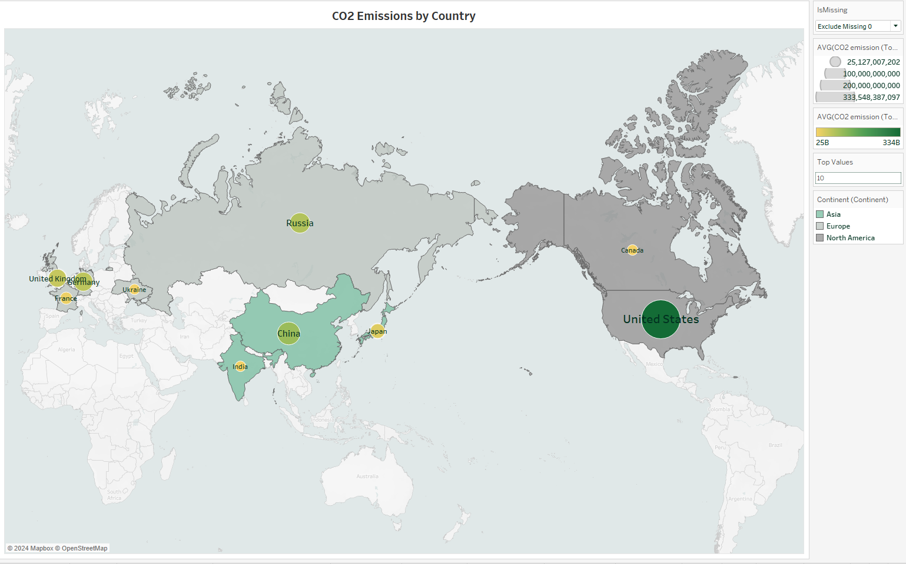
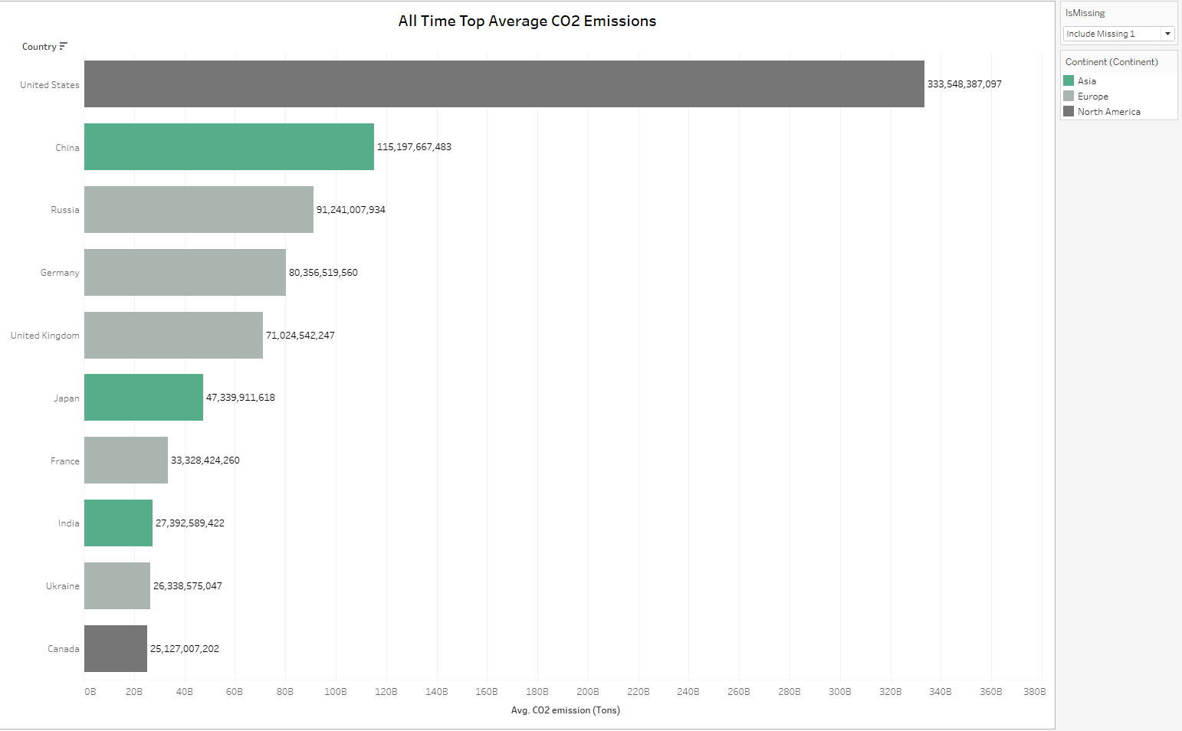



United States
China
Russia
Top emitters mostly belong to Europe, followed by Asia and North America
(Average CO2 emissions)
Introduction
Motivation
Related Works
Dataset
Demo & Results
Future Work
Notes:
As a start, we looked at the all time average CO2 emissions and found the US, China and Russia to be the top emitters.
But this is on the surface level. We have decided to look at the data through different perspectives. For the sake of the presentation, we will focus on perspectives, per capita and time.

Slide 19
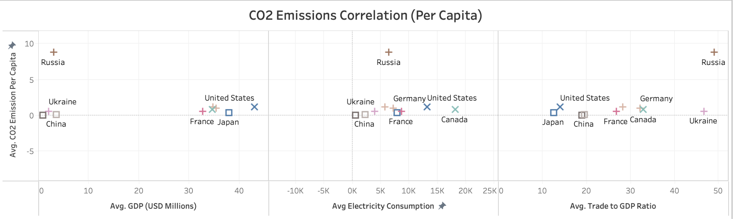
Per Capita Analysis
Weighing Average CO2 emissions Per Capita against Average GDP, Average Electricity Consumption and Average Trade To GDP, Russia is now the top emitter !
Introduction
Motivation
Related Works
Dataset
Demo & Results
Future Work
Notes:
Percapita co2 emissions weighed against 3 factors found in our dataset. We did this for the top 10 emitters and what we were surprised to find was russia being the top per capita. We then wanted to understand which factor might correlate with this findings. Perhaps could it be average trade to gdp ratio?

Slide 20
Correlation between CO2 emission and other factors
0.80
0.68
0.05
0.36
Electricity Consumption
Export Trade
Total Trade
Country Area (km2)
0.89
0.79
0.09
-0.29
Gross Domestic Product
(GDP)
Import Trade
Population
Trade to GDP Ratio
More significant factors
Introduction
Motivation
Related Works
Dataset
Demo & Results
Future Work
Notes:
So we did a correlation of co2 emissions to all other factors that we could consider.
Found that trade to gdp ratio is really irrelevant in explaining why russia tops the percapita.
There were other more significant factors.

Slide 21
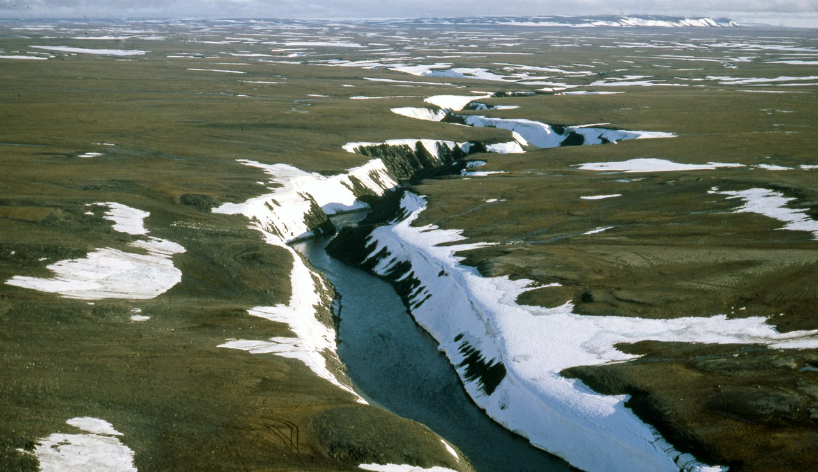
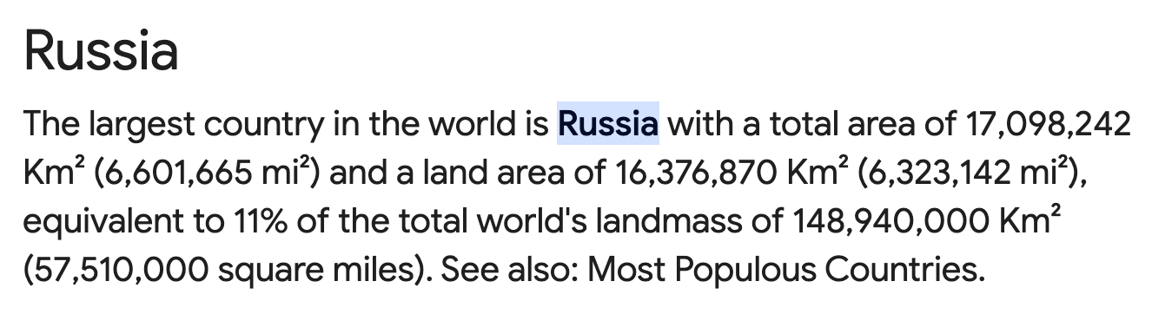
A Deeper Look at Russia’s CO2 Emission Anomaly
Largest Country In The World
⅔ covered by melting permafrost, which releases 6 years worth of coal, oil and natural gas for every 1 degree increase in global temperatures!
Introduction
Motivation
Related Works
Dataset
Demo & Results
Future Work
Notes:
Russia is uniquely the world’s largest country in the world, and adding to that, is two-thirds covered by permafrost, which releases large amounts of greenhouse gases as global temperatures rises. According to one study, a 30 to 99 percent reduction in near-surface permafrost would release an additional 10 to 240 billion tons of carbon and methane into the atmosphere and potentially put the globe “over the brink” by 2100.” “For every one degree Celsius rise in Earth’s average temperature permafrost may release the equivalent of four to six years’ worth of coal, oil, and natural gas emissions” Thus, while Russia tops the world charts along with the US in terms of emissions from the Gas and Coal industry, other unique factors pertaining to its environmental climate are responsible for its unusually high emissions.

Slide 22
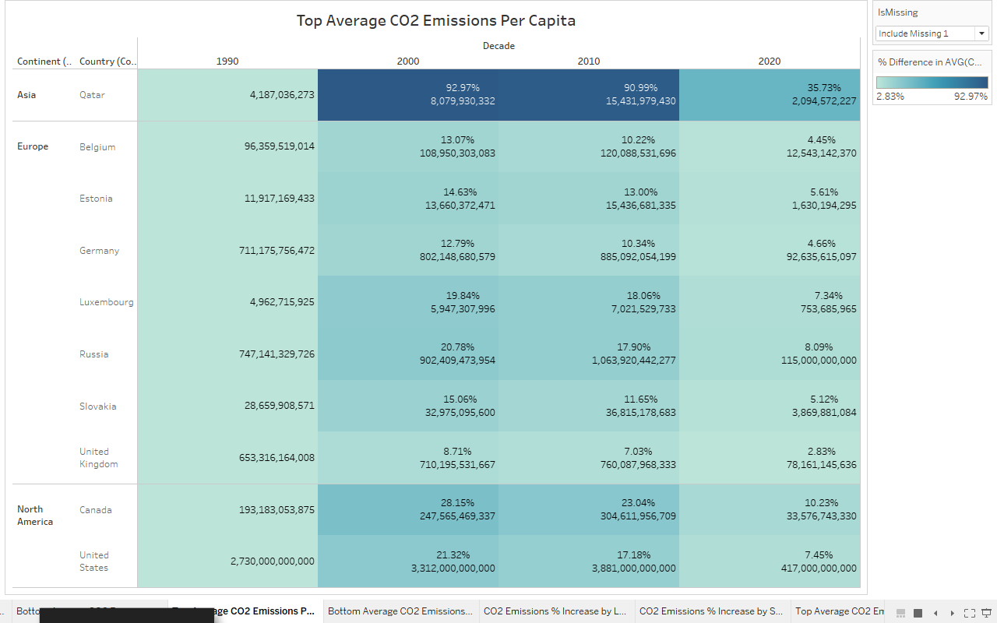
Time Analysis - Top Average CO2 Emissions Per Capita
China and India are no longer CO2 Top Emitters
Qatar being the country with the highest % increase in CO2 Emission
Qatar is the largest Liquefied Natural Gas (LNG) producer and has a relatively small population.
Introduction
Motivation
Related Works
Dataset
Demo & Results
Future Work
Notes:
https://www.qscience.com/content/papers/10.5339/qfarc.2018.EEPD592#:~:text=Qatar%20has%20the%20highest%20CO2,gas%20reserves%20in%20the%20world.
Next we decided to do a time analysis where were studying the percentage of carbon emissions per capita over the decades.
If we rank the countries by CO2 emissions per capita, we find that China and India have disappeared from the top emissions, while the US, Russia, Germany and Canada remain as the top emitters. Majority of the countries remain from Europe and North America, with Qatar, a Middle Eastern country having the highest % increase in emissions. This may reasonably be because Europe… while Qatar’s

Slide 23
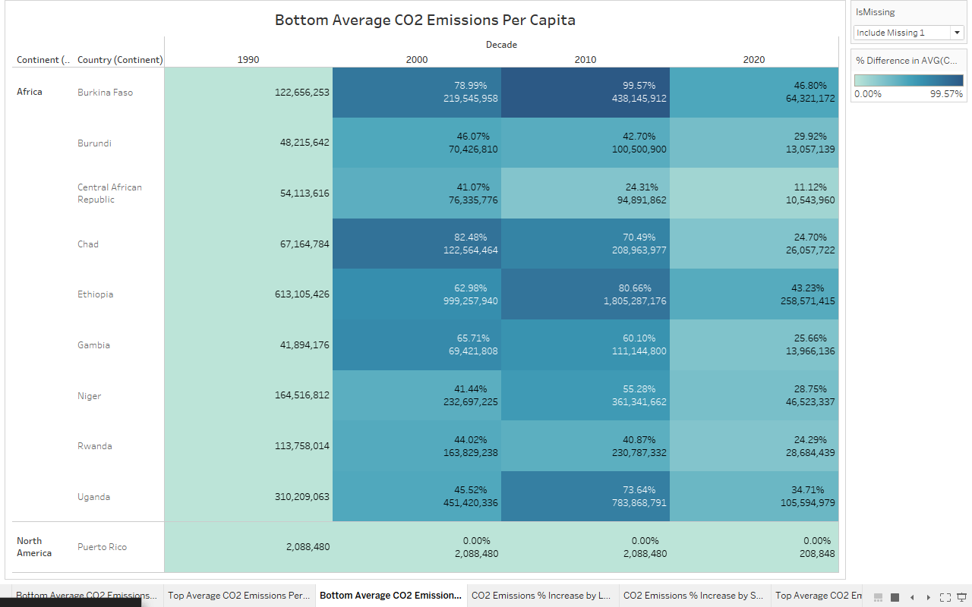
Time Analysis - Bottom Average CO2 Emissions Per Capita
New African countries emerged to have the highest % increase in CO2 Emissions
Burkina Faso has the highest % increase in CO2 Emission. (Burkina Faso is one of the few non resource-rich low-income countries that have been able to achieve high growth over a long period)
Introduction
Motivation
Related Works
Dataset
Demo & Results
Future Work
Notes:
For the lowest emitters, only Puerto Rico remained and new African countries replaced the ranks. Burkina Faso, among the poorest countries in the world—40 percent of its population lives below the national poverty line (World Bank 2020)—and it ranks 182nd out of 189 countries on United Nations Development Program's (UNDP's) 2019 Human Development Index (UNDP 2019) has the highest % increase in emissions.
several key characteristics common to these countries–Burkina Faso, Ethiopia, Mozambique, Rwanda, Tanzania, and Uganda–improved macroeconomic management, stronger institutions, increased aid, and higher investment in human and physical capital.
Burkina Faso: Selected Issues; IMF Country Report No. 14/230, June 18, 2014

Slide 24
06
Future Work
Introduction
Motivation
Related Works
Dataset
Demo & Results
Future Work

Slide 25


Future Work
GNI income
Sector-Based Emissions
Look at GNI income instead of GDP
More comprehensive view of a country's economic activity
Offers insights into the economic factors driving emissions patterns
Industrial activities heavily rely on fossil fuels, emitting CO2 during combustion for energy
Further research to quantify their exact impact on CO2 emissions
Introduction
Motivation
Related Works
Dataset
Demo & Results
Future Work

Slide 26



Conclusion
When conducting CO2 Emissions Analysis, the following can be incorporated to gain a full understanding of the data
Identify potential significant events on
specific time periods
Conduct Qualitative Research
to validate quantitative findings
Consider factors on
a per capita Level
Introduction
Motivation
Related Works
Dataset
Demo & Results
Future Work
Notes:
Consider population size by analysing on a per capita analysis
Looking at time periods and understand certain point rather than focusing on the overall solely, understand key global/ specific events
Research external factors (qualitative data) and characteristics of a country beyond numbers

Slide 27
Thank You!

Slide 28
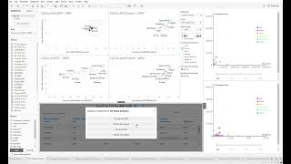
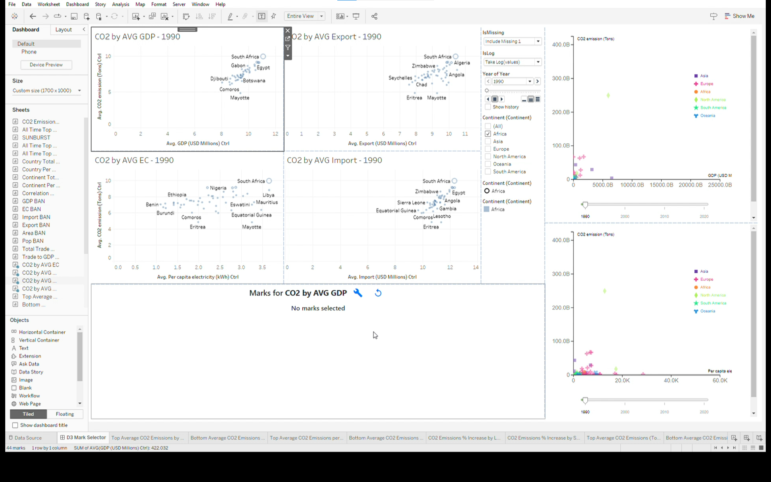



Bonus D3 Demo
Simple setup (all D3 files using .trex extensions)
Open command prompt
cd “file_path_containing_d3”
npm start
Notes:
https://youtu.be/636iOJ56euo

